Slide 1
Gradient Descent
Linear regression with one variable

Slide 2
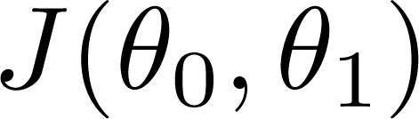
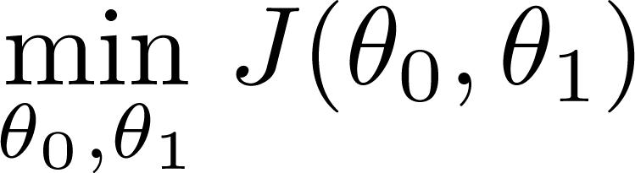
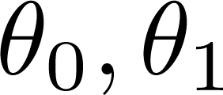
Have some function
Want
Outline:
Start with some
Keep changing to reduce until we hopefully end up at a minimum

Slide 3
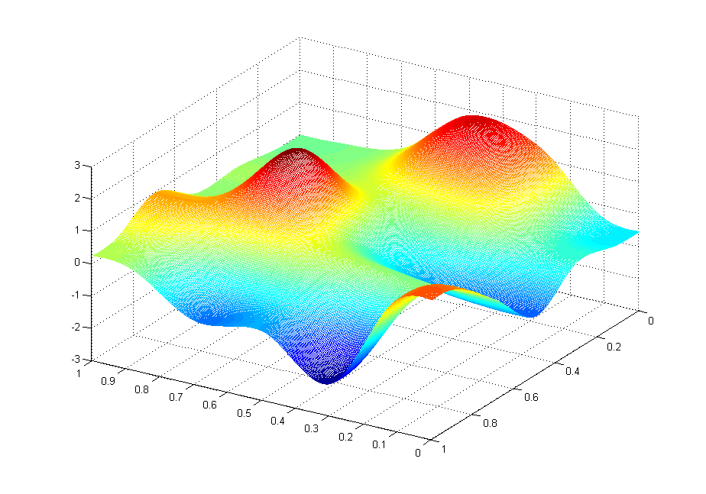
J(θ₀,θ₁)
θ₁
θ₀

Slide 4
J(θ₀,θ₁)
θ₁
θ₀

Slide 5
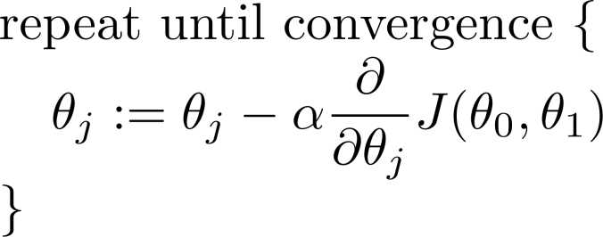
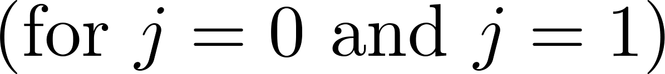
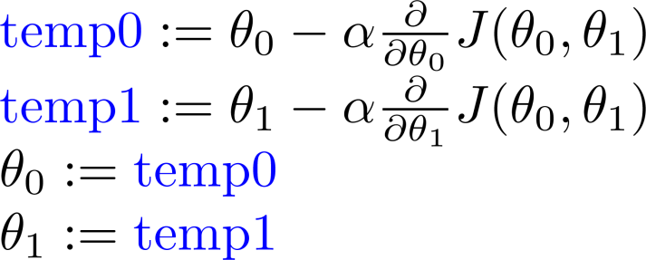
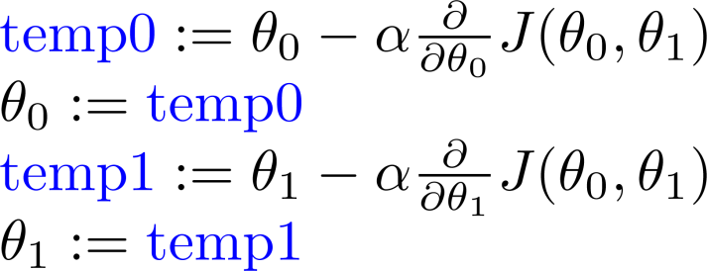
Gradient descent algorithm
Correct: Simultaneous update
Incorrect:

Slide 6
Gradient Descent Intuition
Linear regression with one variable

Slide 7
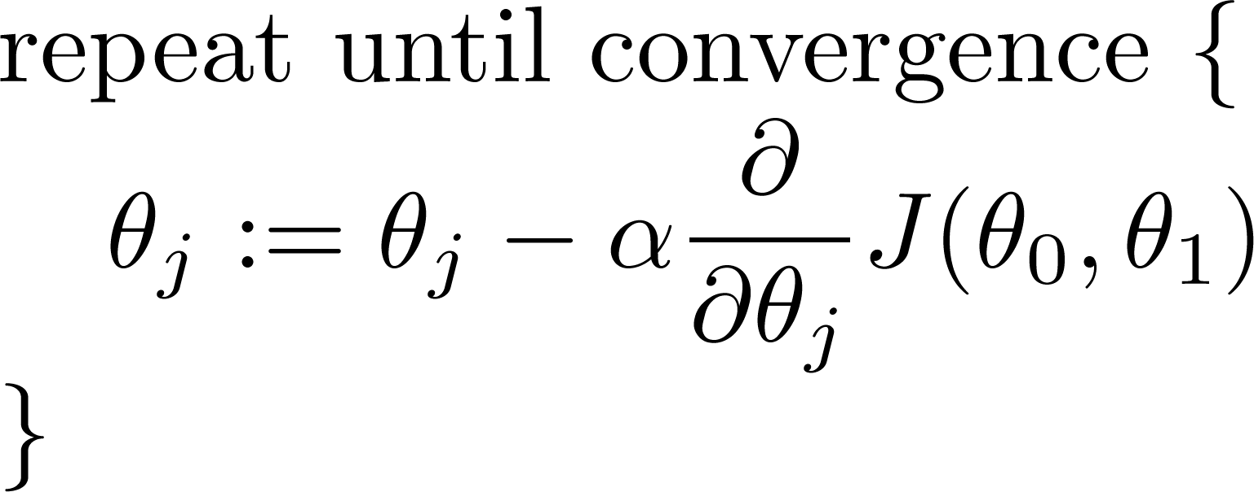
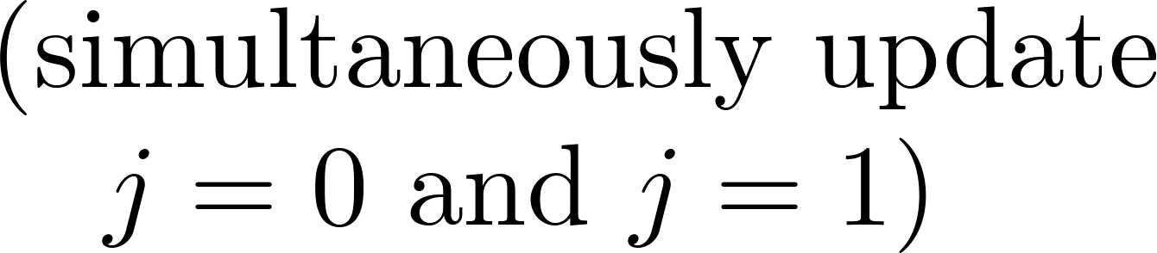
Gradient descent algorithm

Slide 8
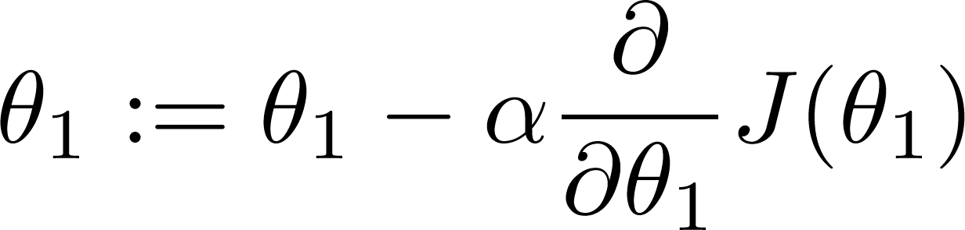

What happens If α is too small?
Gradient descent can be slow.
What if α is too large?
Gradient descent can overshoot the minimum. It may fail to converge, or even diverge.

Slide 9

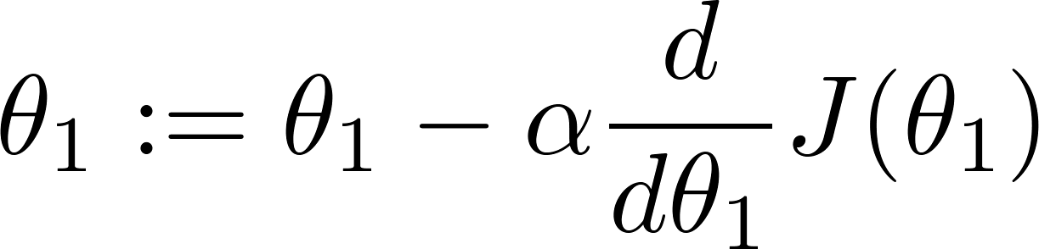
at local optima
Current value of

Slide 10

Gradient descent can converge to a local minimum, even with the learning rate α fixed.
As we approach a local minimum, gradient descent will automatically take smaller steps. So, no need to decrease α over time.

Slide 11
Gradient Descent for Linear Regression
Linear regression with one variable

Slide 12
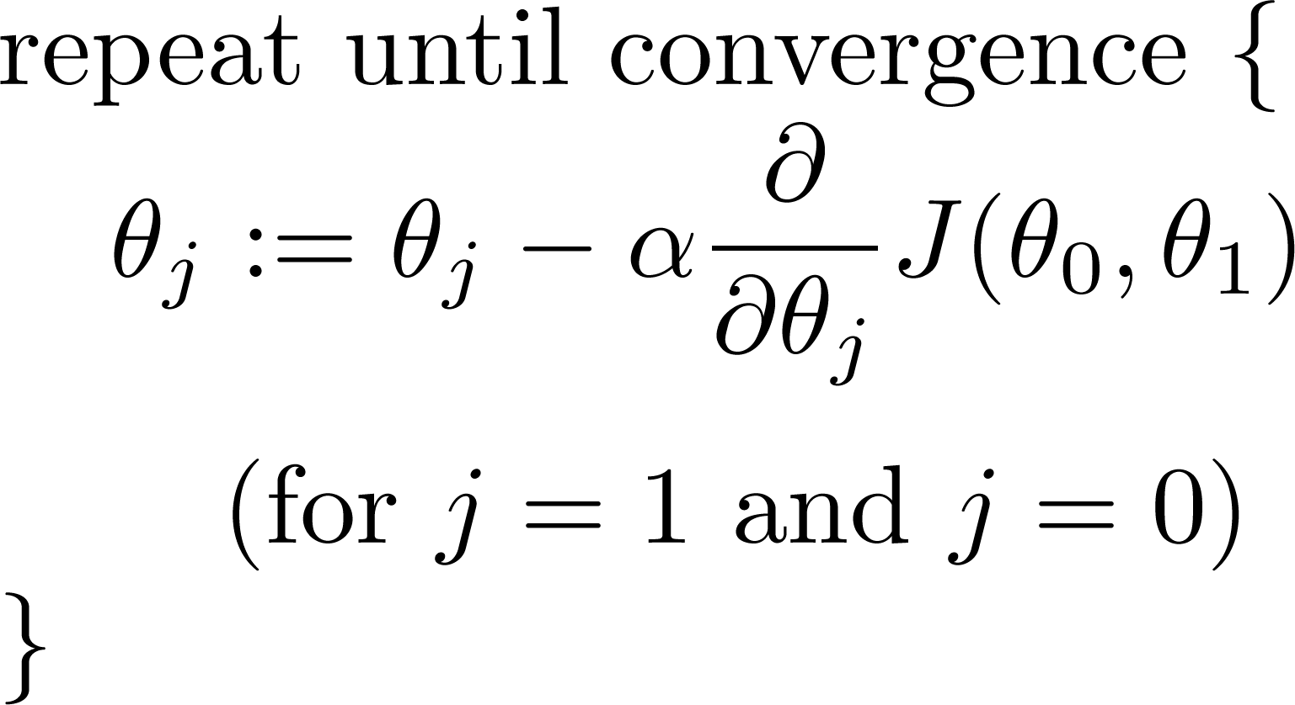
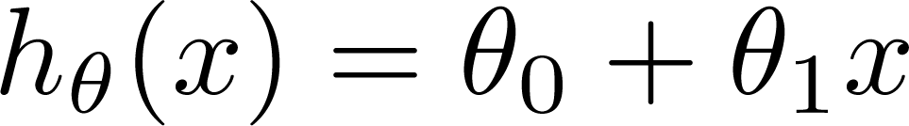
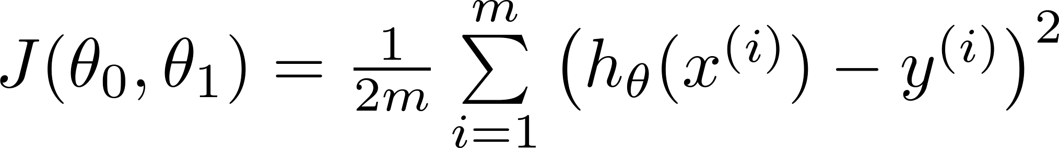
Gradient descent algorithm
Linear Regression Model

Slide 13
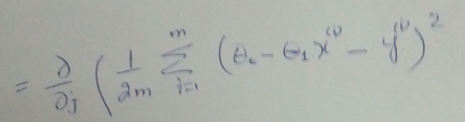
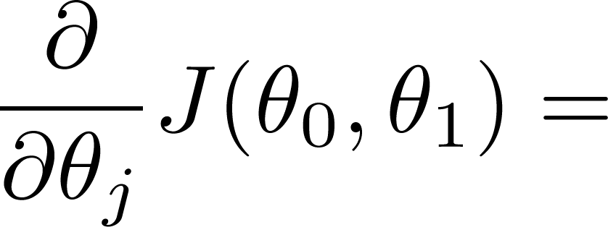
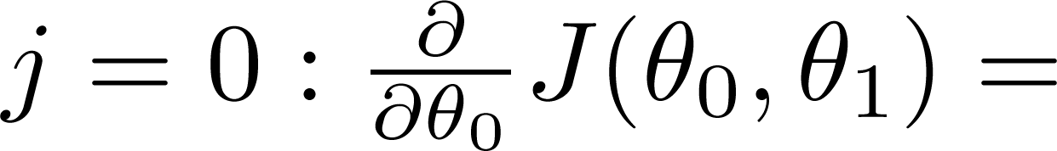
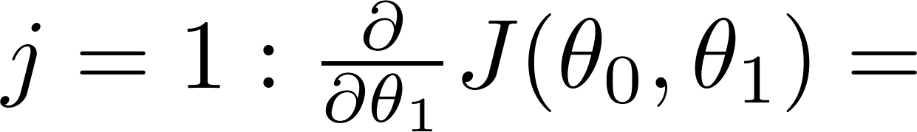

Slide 14
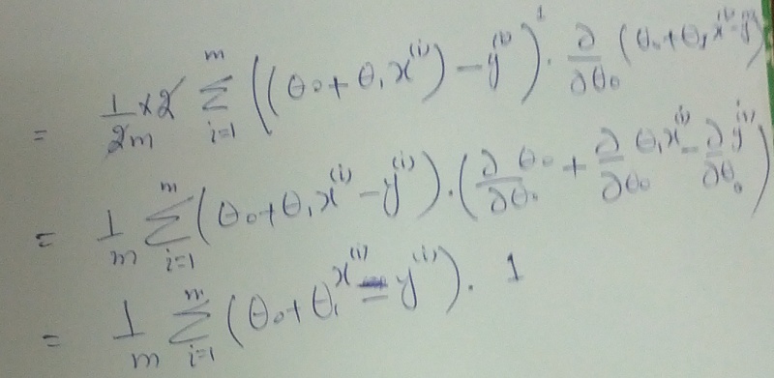

Slide 15
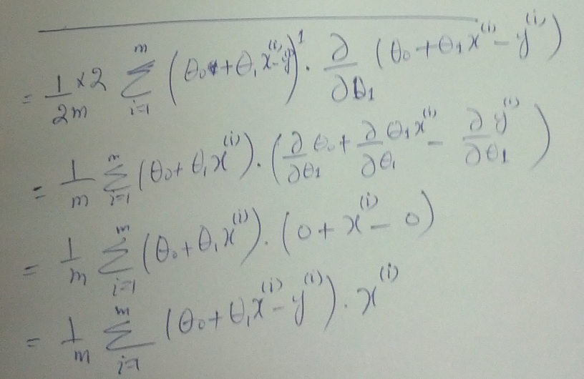

Slide 16
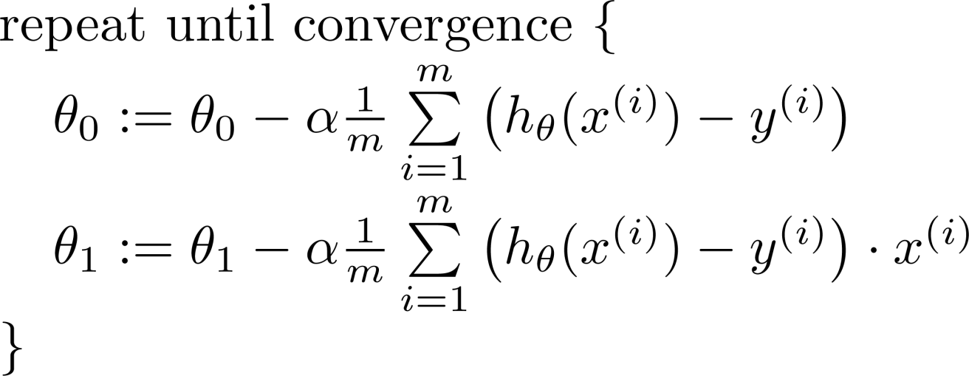

Gradient descent algorithm
update
and
simultaneously

Slide 17
J(θ₀,θ₁)
θ₁
θ₀

Slide 18
J(θ₀,θ₁)
θ₁
θ₀

Slide 19
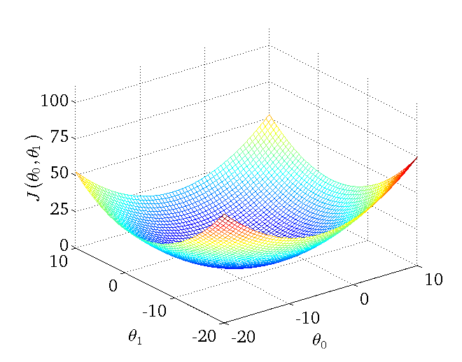

Slide 20



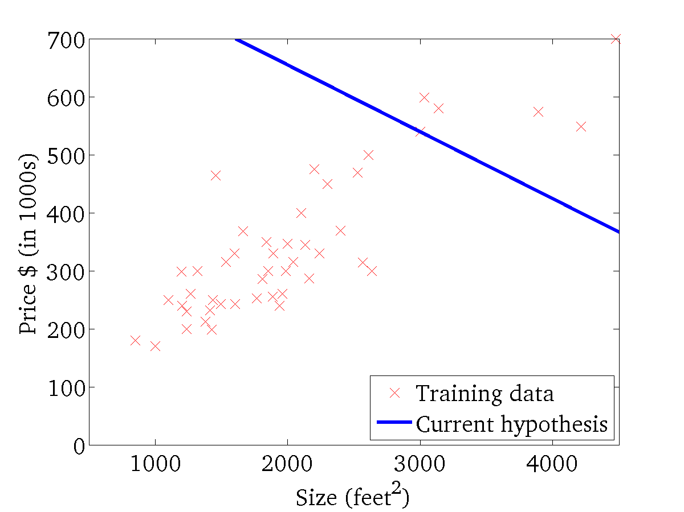
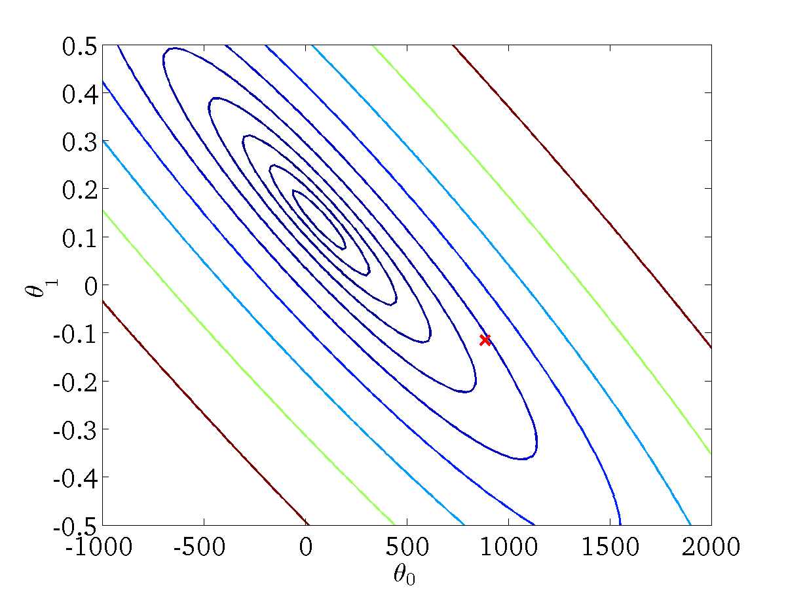
(for fixed , this is a function of x)
(function of the parameters )

Slide 21
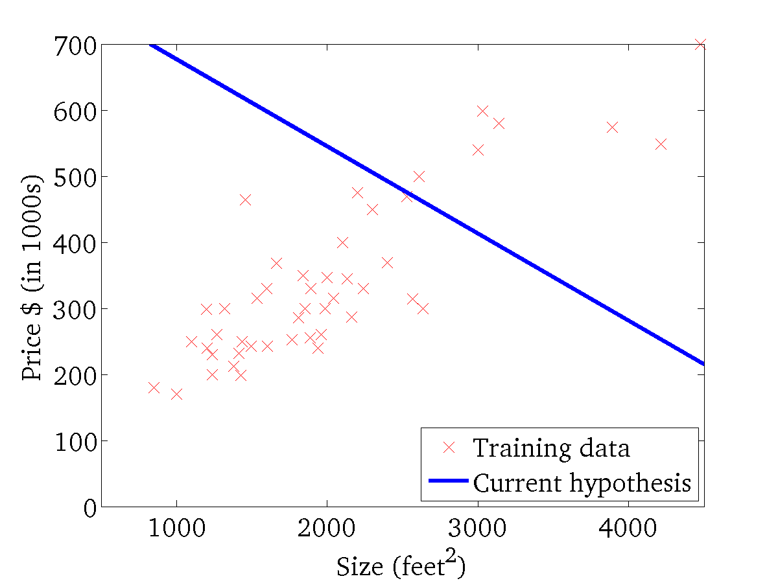

(for fixed , this is a function of x)
(function of the parameters )

Slide 22
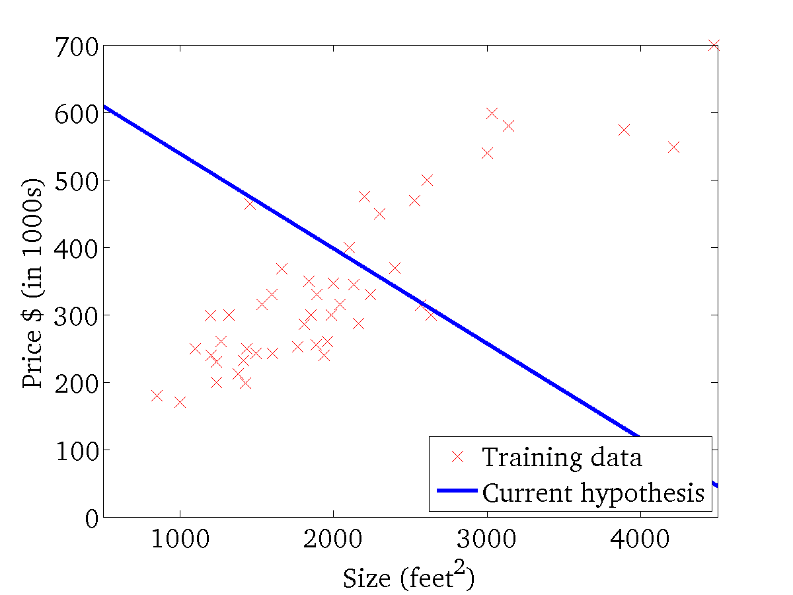
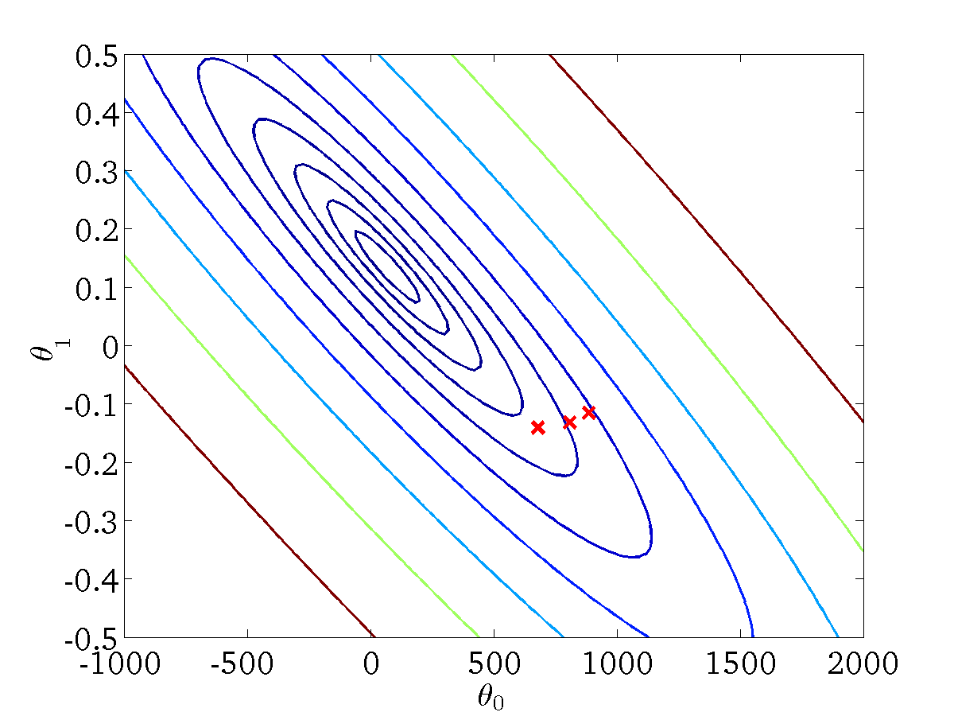
(for fixed , this is a function of x)
(function of the parameters )

Slide 23
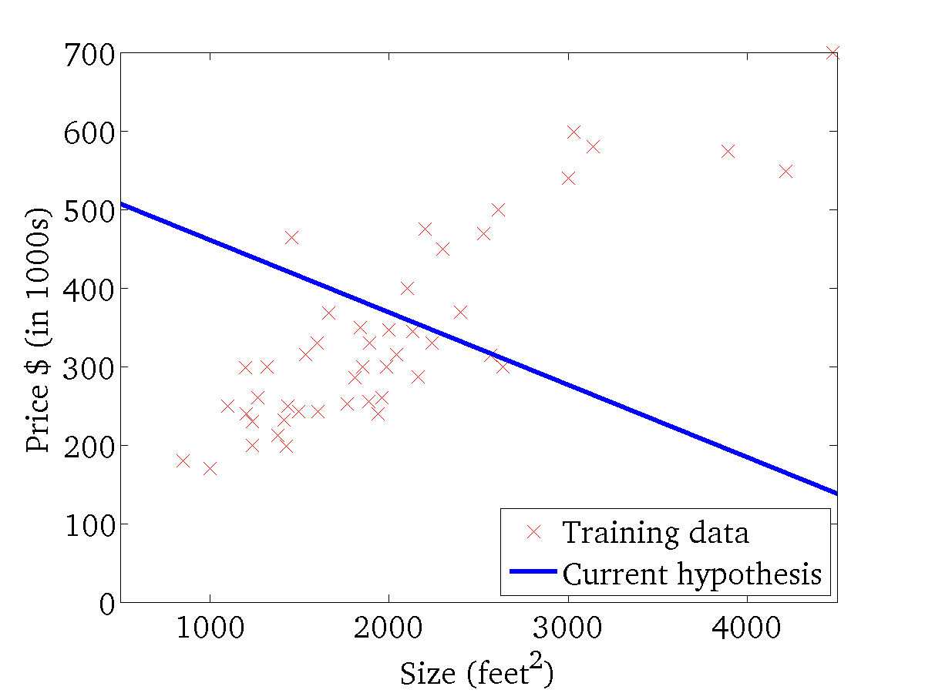

(for fixed , this is a function of x)
(function of the parameters )

Slide 24
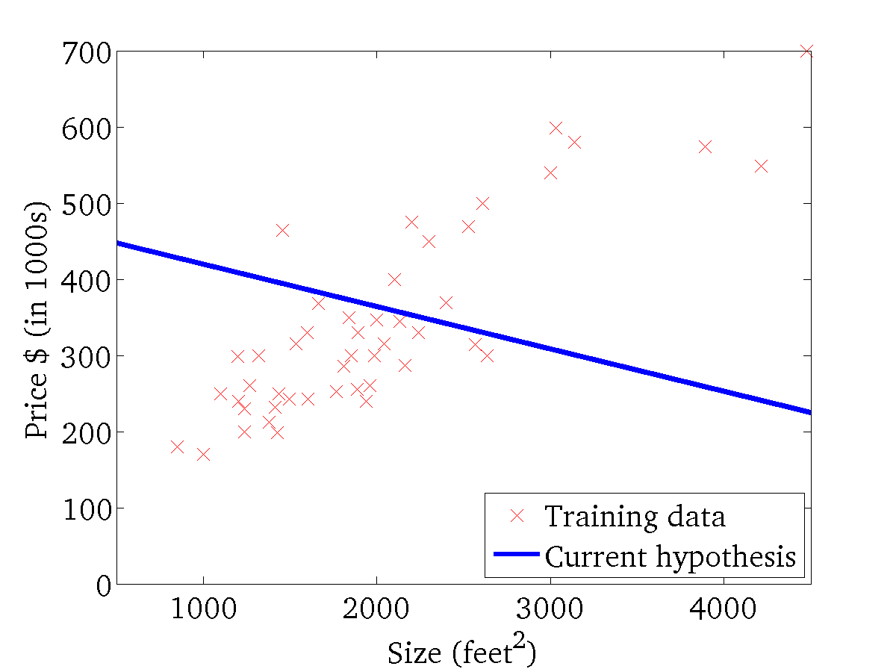
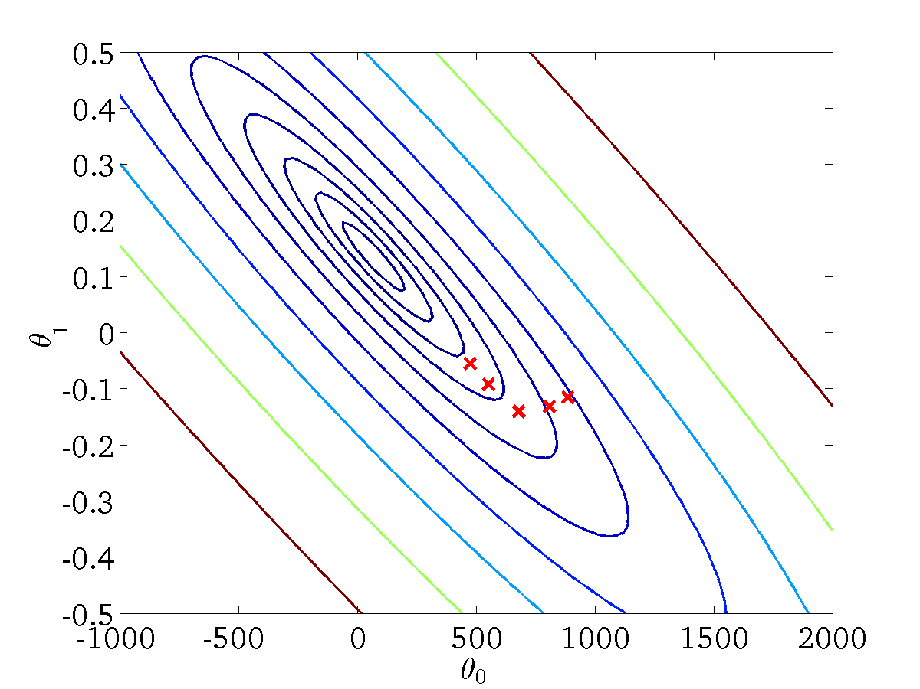
(for fixed , this is a function of x)
(function of the parameters )

Slide 25
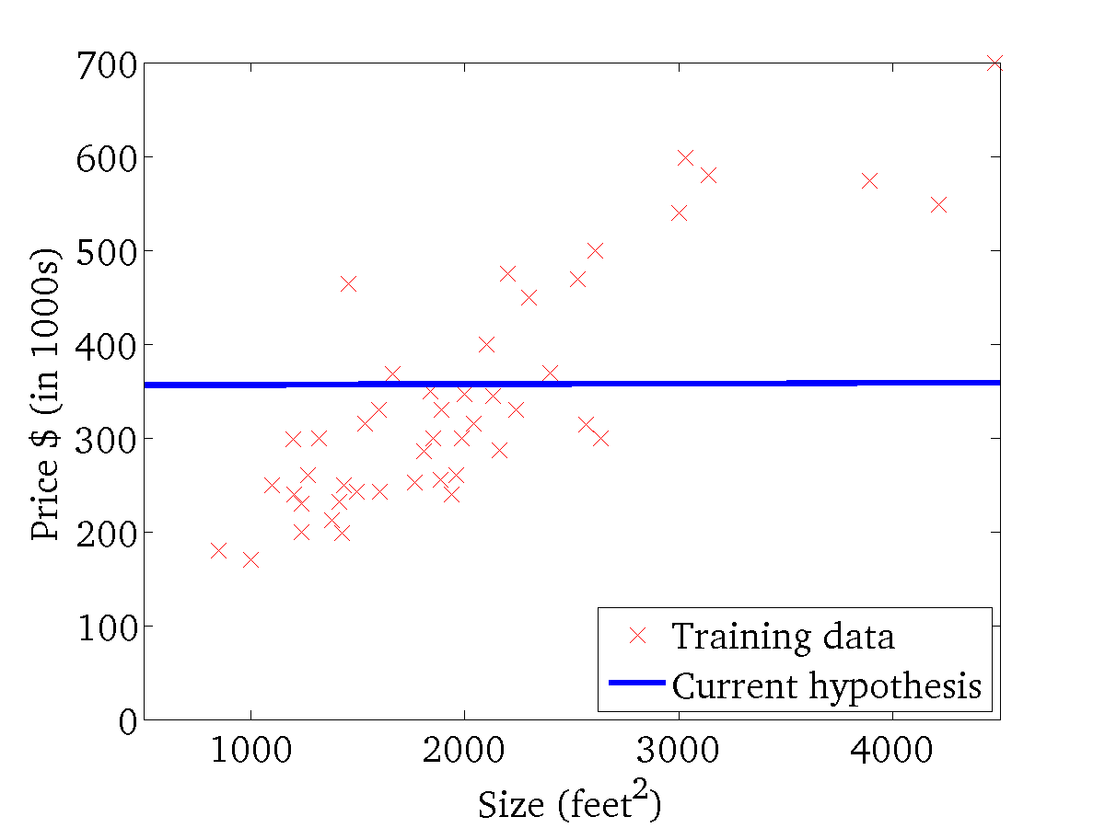

(for fixed , this is a function of x)
(function of the parameters )

Slide 26
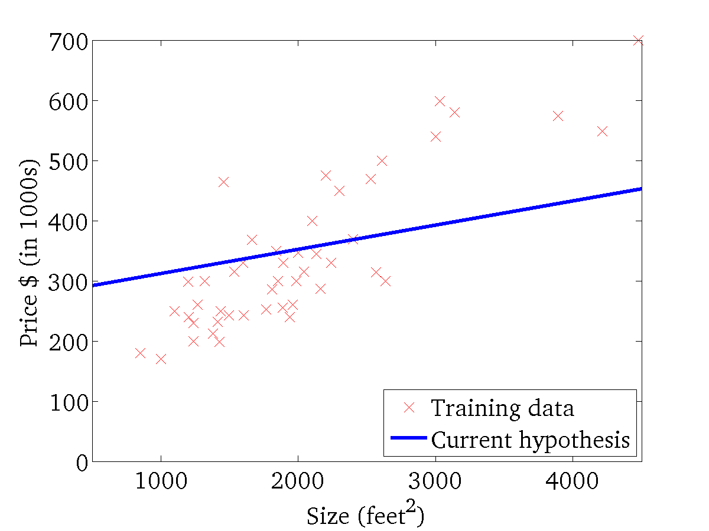

(for fixed , this is a function of x)
(function of the parameters )

Slide 27
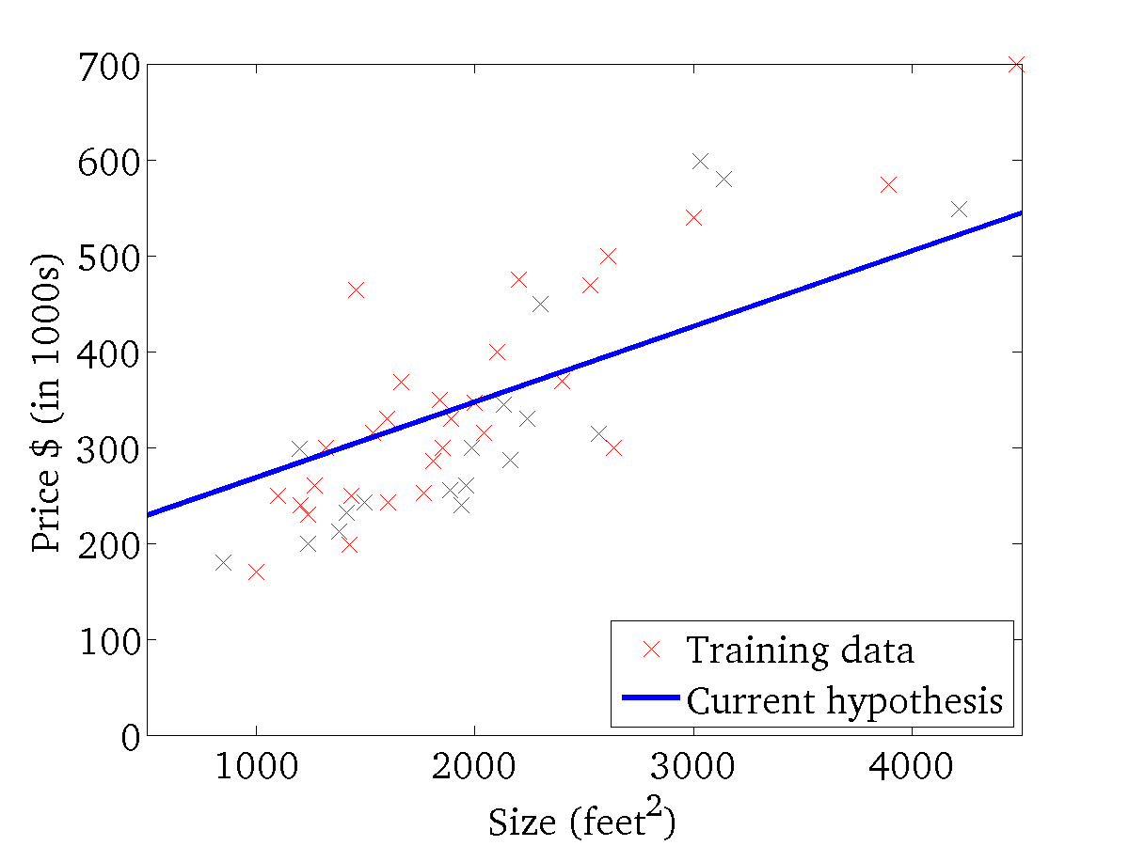
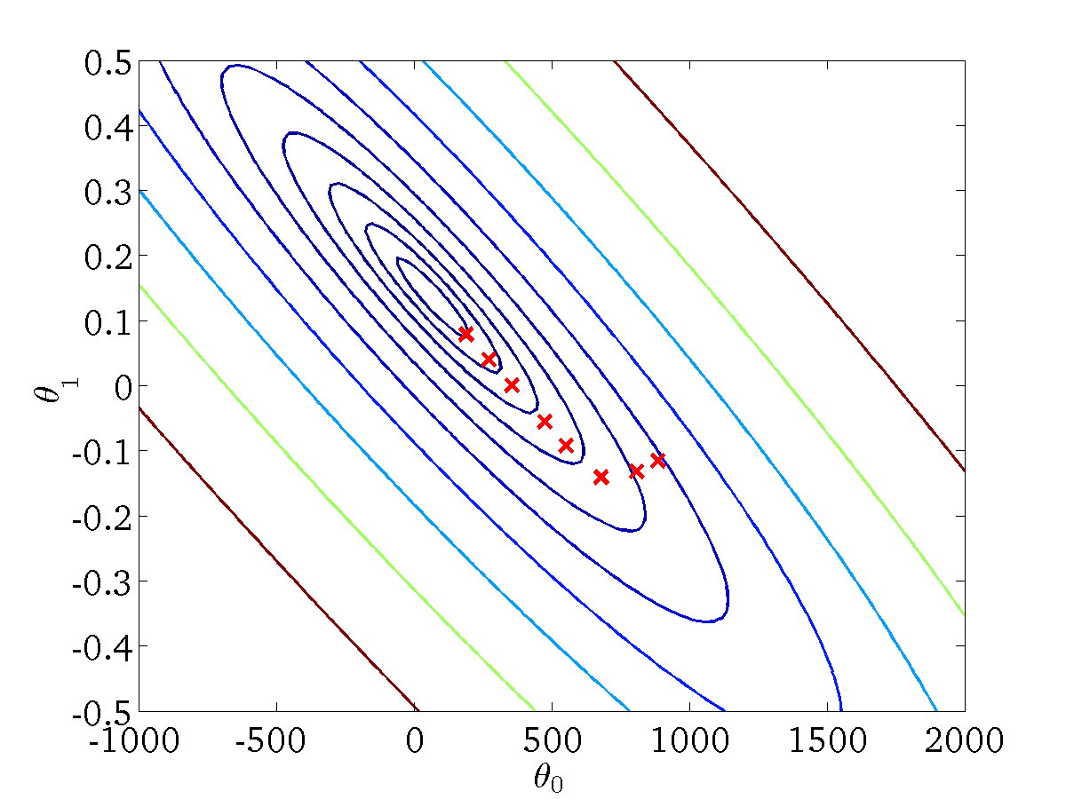
(for fixed , this is a function of x)
(function of the parameters )

Slide 28
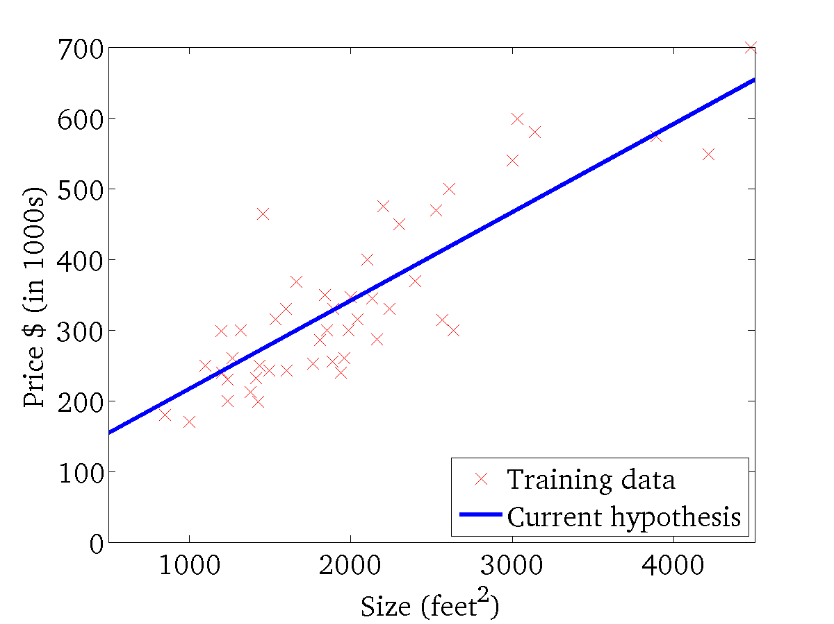

(for fixed , this is a function of x)
(function of the parameters )

Slide 29
“Batch” Gradient Descent
“Batch”: Each step of gradient descent uses all the training examples.

Slide 30
What’s Next

Slide 31
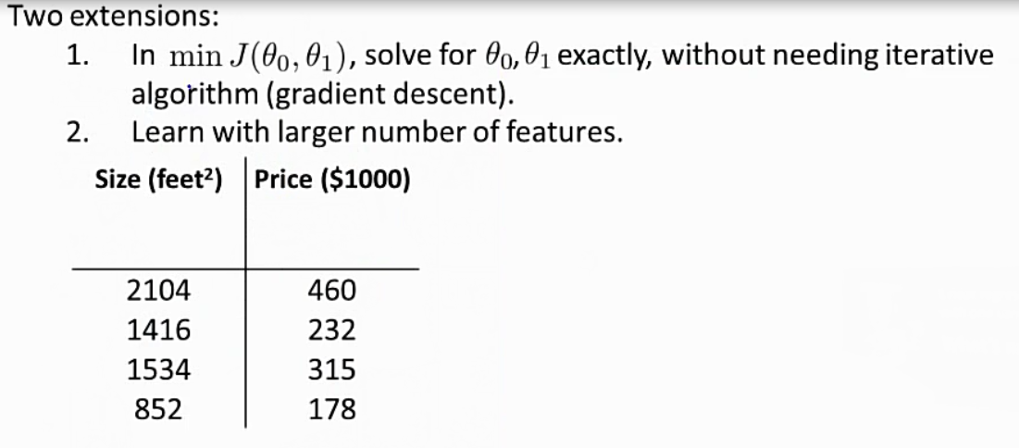

Slide 32
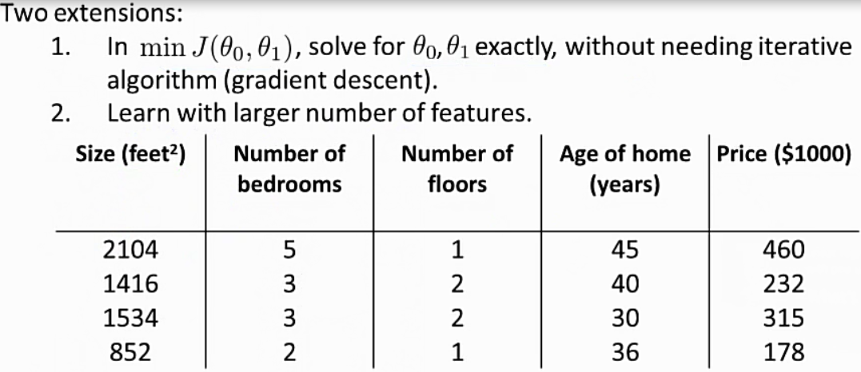

Slide 33
